Slide 1
Welcome

Slide 2
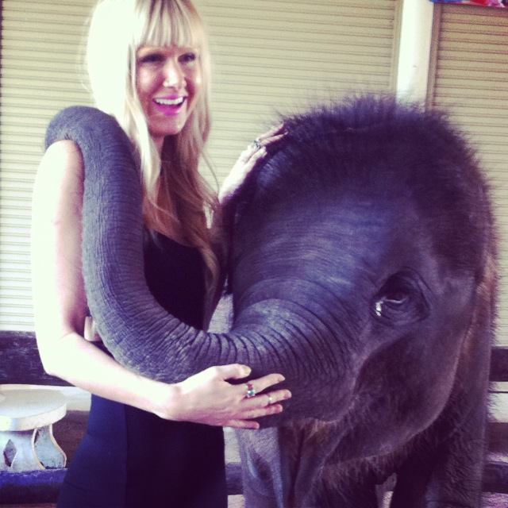
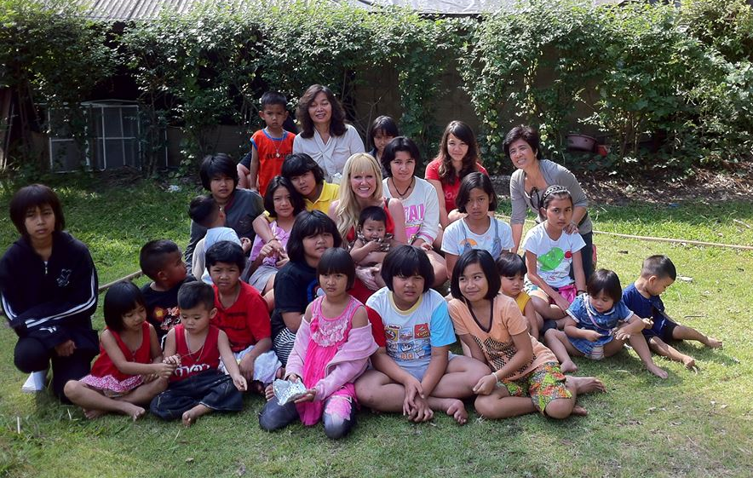
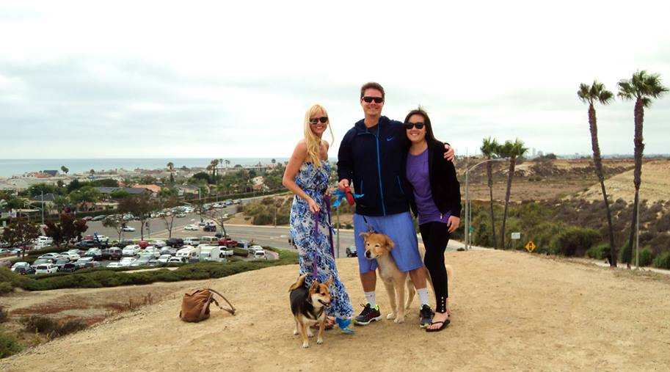
I grew up in Southern California and graduated from Concordia University. I love nature and to be active (soccer, hiking, marathons, yoga). I lived and taught in Eastern Europe and Asia for 5 years and enjoyed traveling around the world and learning about different cultures. I have a passion for teaching science and I like to incorporate lots of hands-on labs/projects. I know we are going to have an AWESOME year!

Slide 3
Shortly after you enter class, I will put two fingers up to ask for your attention. I will expect…
To see every student sitting in a chair ready to learn.
silence throughout the room when I ask for your attention.
Every student with the proper materials for learning.
Student journals open to the next available page.

Slide 4
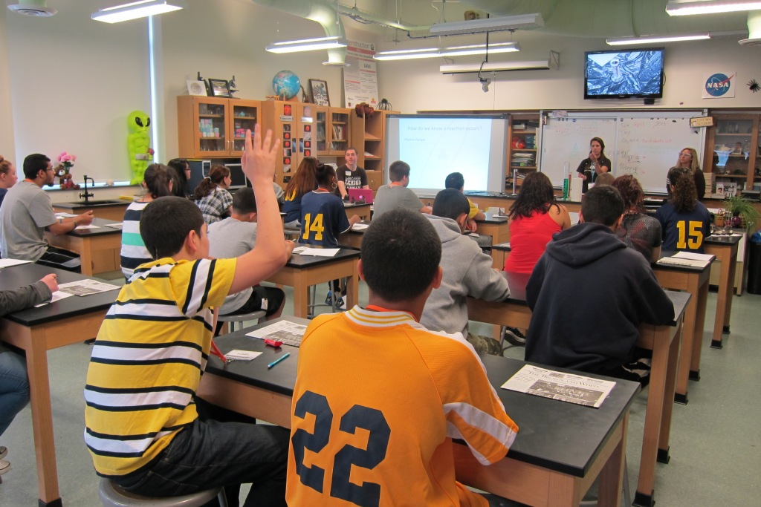
You are going to have an amazing educational experience this year!
You will meet new friends, explore the outdoors, stand up in front of your peers, conduct your own science research, play games, and have many new experiences. Welcome to our classroom, and I look forward to getting to know you more ☺

Slide 5
My Responsibilities
To Treat you with care and respect.
To provide you an orderly classroom.
To provide you the necessary discipline.
To teach you the required content.
To provide the appropriate motivation.
My

Slide 6
Which of the pictures below looks like what our classroom should look like?

Slide 7
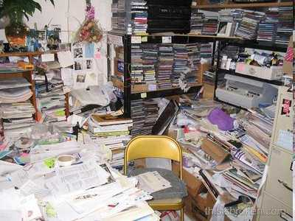
Which of the pictures below looks like what our classroom should look like?
A

Slide 8
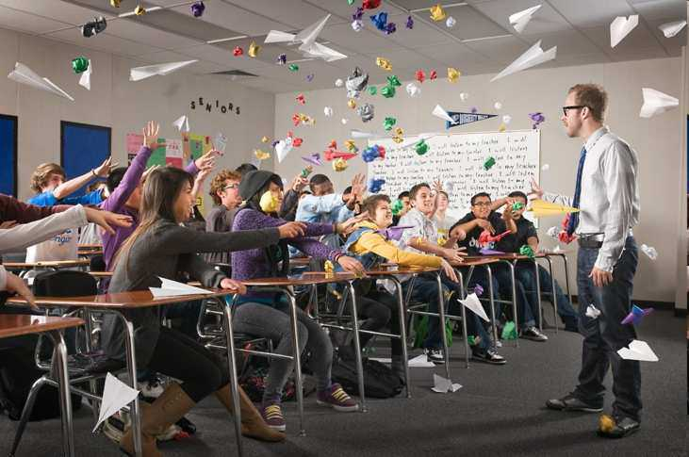
Which of the pictures below looks like what our classroom should look like?
A
B

Slide 9
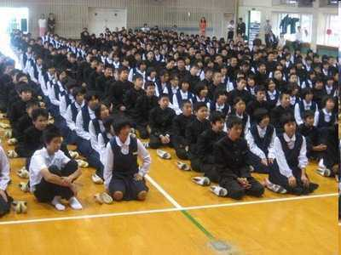
Which of the pictures below looks like what our classroom should look like?
A
B
C

Slide 10
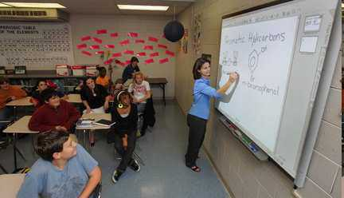
Which of the pictures below looks like what our classroom should look like? Answer…
A
B
C
D

Slide 11
Which of the pictures below looks like what our classroom should look like? Answer…
A
B
Our room should be clean and organized at all times.
C
D

Slide 12
Which of the pictures below looks like what our classroom should look like? Answer…
B
C
D

Slide 13
Which of the pictures below looks like what our classroom should look like? Answer…
B
You will need to show me respect at all times.
C
D

Slide 14
Which of the pictures below looks like what our classroom should look like? Answer…
C
D

Slide 15
Which of the pictures below looks like what our classroom should look like? Answer…
C
D
This is amazing, but maybe a bit much for us right now.

Slide 16
Which of the pictures below looks like what our classroom should look like? Answer…
D

Slide 17
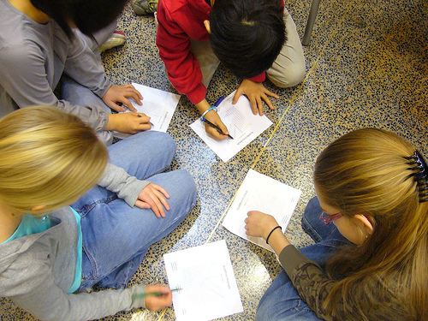
Your Responsibilities
To treat myself and classmates with care and respect.
To attend classes regularly.
To be cooperative and not disruptive.
To study and do your best (success = effort)
To learn and master the required content.

Slide 18
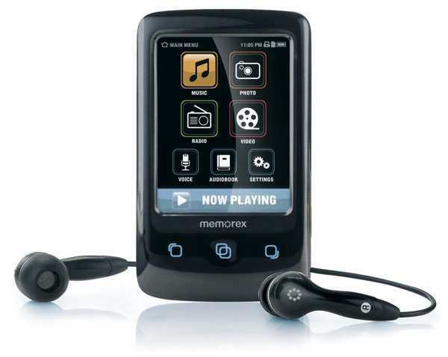
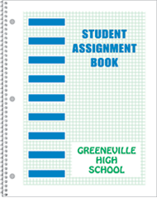
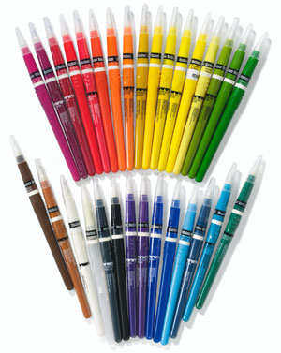
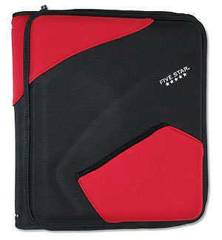
Activity! What 3-5 items should you bring to class from the pictures below?
A
B
C
D
G
H
E
F
I
J
K

Slide 19
Activity! What 3-5 items should you bring to class from the pictures below?
A
B
C
D
G
H
E
F
I
J
K

Slide 20
Activity! What 3-5 items should you bring to class from the pictures below?
B
C
D
G
H
E
F
I
J
K

Slide 21
Activity! What 3-5 items should you bring to class from the pictures below?
B
C
D
G
H
E
F
I
J
K

Slide 22
Activity! What 3-5 items should you bring to class from the pictures below?
B
C
D
G
H
E
F
I
J
K

Slide 23
Activity! What 3-5 items should you bring to class from the pictures below?
B
D
G
H
E
F
I
J
K

Slide 24
Activity! What 3-5 items should you bring to class from the pictures below?
B
D
G
H
E
F
I
J
K

Slide 25
Activity! What 3-5 items should you bring to class from the pictures below?
B
D
G
H
E
F
I
J
K

Slide 26
Activity! What 3-5 items should you bring to class from the pictures below?
B
D
G
H
E
F
I
J
K

Slide 27
Activity! What 3-5 items should you bring to class from the pictures below?
B
D
G
H
E
F
I
J
K

Slide 28
Activity! What 3-5 items should you bring to class from the pictures below?
B
D
G
H
E
F
I
J
K

Slide 29
Activity! What 3-5 items should you bring to class from the pictures below?
B
D
G
H
E
I
J
K

Slide 30
Activity! What 3-5 items should you bring to class from the pictures below?
B
D
G
H
E
I
J
K

Slide 31
Activity! What 3-5 items should you bring to class from the pictures below?
B
D
H
E
I
J
K

Slide 32
Activity! What 3-5 items should you bring to class from the pictures below?
B
D
H
E
I
J
K

Slide 33
Activity! What 3-5 items should you bring to class from the pictures below?
B
D
E
I
J
K

Slide 34
Activity! What 3-5 items should you bring to class from the pictures below?
B
D
E
I
J
K

Slide 35
Activity! What 3-5 items should you bring to class from the pictures below?
B
D
E
I
J
K

Slide 36
Activity! What 3-5 items should you bring to class from the pictures below?
B
D
E
I
J
K

Slide 37
Activity! What 3-5 items should you bring to class from the pictures below?
B
D
E
I
K

Slide 38
Activity! What 3-5 items should you bring to class from the pictures below?
B
D
E
I
K

Slide 39
Activity! What 3-5 items should you bring to class from the pictures below?
B
D
E
I
K

Slide 40
Activity! What 3-5 items should you bring to class from the pictures below?
B
D
E
Which three are most important?
I
K

Slide 41
Activity! What 3-5 items should you bring to class from the pictures below?
B
D
Which three are most important?
K

Slide 42
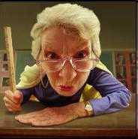
What does it mean to come to class prepared ?
You will need to arrive on time with…

Slide 43
What does it mean to come to class prepared ?
You will need to arrive on time with…
Science notebook
Organizer or folder
Assignment book/agenda
Pens and pencils (tool-kit)

Slide 44
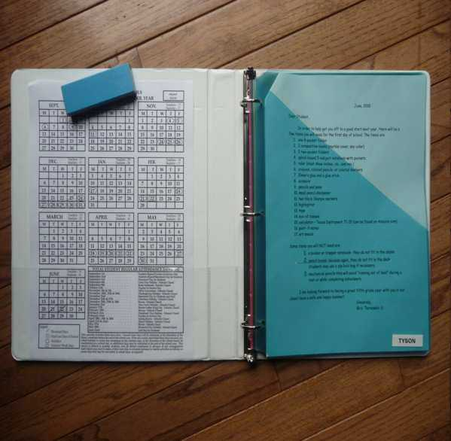
Staying Organized
I expect you to save all your graded lab write-ups, and assignments throughout the year.
The easiest and neatest way to do this is in your science notebooks

Slide 45
At the beginning of class…
Come into class and take your seat.
Pull out your science journal and open it to the first available page.
Sharpen your pencil before class begins.
Get started on the Bell Ringer

Slide 46
Please make sure that you go to the restroom and fill your water bottles in the morning before you come to school. If you need to use the restroom during the school day it should be before school, during lunch, passing periods, or after school. You will receive 4 bathroom passes per trimester, use them wisely. Any leftover passes can be used as extra credit, woohoo!

Slide 47
Turning in Work
Homework or unfinished work will be collected at the beginning of class.
Labs and classwork will be turned in at the end of class (unless extra time is needed).
PUT YOUR NAME ON YOUR PAPERS! (No name, no credit)

Slide 48
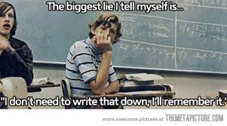
End of the Class
Everyone must write all homework and project due dates in their planner! You’ll forget, trust me.
Once you have packed up you need to pick up your floor and make sure your area is clean. I’m not your housekeeper !!!

Slide 49
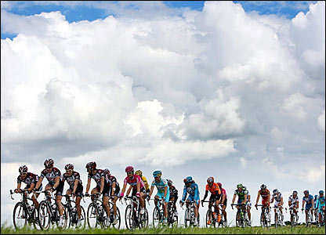
A strong start to class = A good class for everyone.

Slide 50
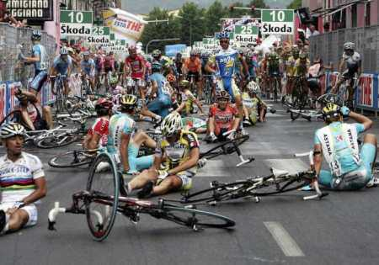
A poor start of class =

Slide 51
A poor start of class = A weaker class.

Slide 52
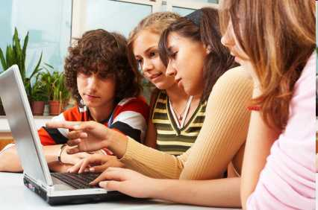
Is this picture an example of students cheating?

Slide 53
Is this picture an example of students cheating?
No, the students are working together and helping each other.

Slide 54
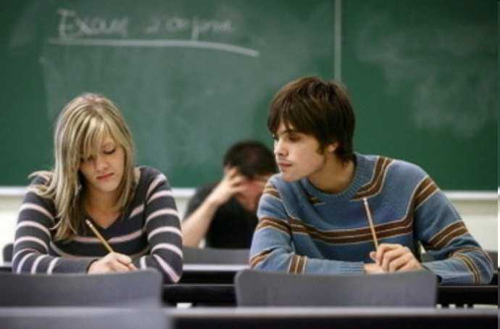
Is this picture an example of a student cheating?

Slide 55
Is this picture an example of a student cheating?
Yes, This student will definitely be in trouble. Cheating isn’t worth it. It only cheats your hopes and dreams.

Slide 56
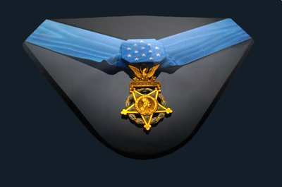
You can teach by…
Showing someone the steps/process of how to get the right answer.
Point out, and go through examples.
Go online, help is always a few clicks away.
Verbalize / summarize how you got your correct answer.

Slide 57
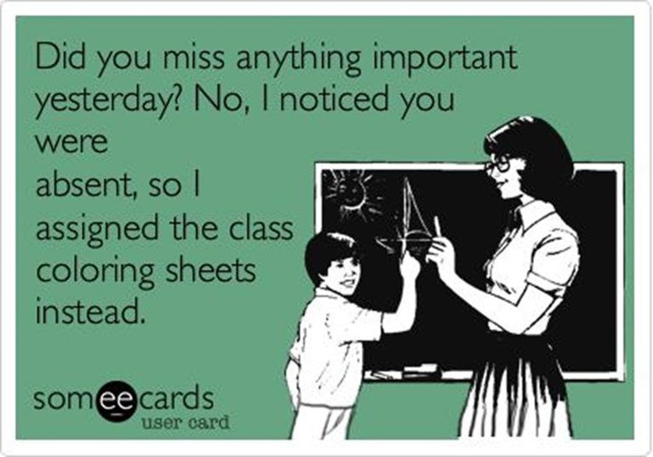
If you are absent...BE PROACTIVE!
Check my website for what was missed
See me when you get back, I won’t find you.
Get the notes from the computer or a friend.
If it was a lab, let me show you what happened in tutorial .

Slide 58
Please guess the mystery street below as I slowly remove the boxes.
Raise your hand when you think you know.

Slide 59
Please guess the mystery street below as I slowly remove the boxes.
Raise your hand when you think you know.

Slide 60
Please guess the mystery street below as I slowly remove the boxes.
Raise your hand when you think you know.

Slide 61
Please guess the mystery street below as I slowly remove the boxes.
Raise your hand when you think you know.

Slide 62
Please guess the mystery street below as I slowly remove the boxes.
Raise your hand when you think you know.

Slide 63
Please guess the mystery street below as I slowly remove the boxes.
Raise your hand when you think you know.

Slide 64
Please guess the mystery street below as I slowly remove the boxes.
Raise your hand when you think you know.

Slide 65
Please guess the mystery street below as I slowly remove the boxes.
Raise your hand when you think you know.

Slide 66
Please guess the mystery street below as I slowly remove the boxes.
Raise your hand when you think you know.

Slide 67
Please guess the mystery street below as I slowly remove the boxes.
Raise your hand when you think you know.

Slide 68
Please guess the mystery street below as I slowly remove the boxes.
Raise your hand when you think you know.

Slide 69
Please guess the mystery street below as I slowly remove the boxes.
Raise your hand when you think you know.

Slide 70
It’s Opportunity.
This year is your opportunity to shine.

Slide 71
A few ground rules that need to be followed along with the class code.
Don’t shout out, please raise your hand.
One speaker at a time.
Movement with a purpose (academic).
Clean up after yourself.

Slide 72
Which one of the following is not an actual ground rule?
A.) Don’t shout out, please raise your hand.
B.) One speaker at a time.
C.) No talking.
D.) Movement with a purpose (academic).
E.) Clean up after yourself.

Slide 73
Which one of the following is not an actual ground rule?
A.) Don’t shout out, please raise your hand.
B.) One speaker at a time.
C.) No talking.
D.) Movement with a purpose (academic).
E.) Clean up after yourself.

Slide 74
Which one of the following is not an actual ground rule?
A.) Don’t shout out, please raise your hand.
B.) One speaker at a time.
C.) No talking.
D.) Movement with a purpose (academic).
E.) Clean up after yourself.
“We need to talk in order to learn this year.” “Discussion needs structure.”

Slide 75
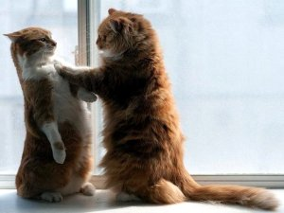
Discipline and Class Rules
All school wide expectations carry over into my classroom. Logical consequences will be given to students who have difficulties with school policies.
In class, you will be given a warning for the first offense. The second time will constitute cleaning duty, detention, or loss of break/lunch time. The third offense will result in a parent call and possible conference and behavior contract.

Slide 76
Teacher Pet Peeves
Please do not waste school supplies! So making bracelets out of tape or pouring half a bottle of glue on your paper is not cool, it’s annoying and a waste on money! Please use supplies appropriately or I will have you personally buy the class supplies after wasting them.
Drop the attitude... I am a very understanding person and I know we all have difficult things going on in our lives, but that does not give you permission to be rude to others. I understand if you’re having a bad day. Please let me know and I’m happy to let you work on your own, outside the class, or to go see the councilor if you want.

Slide 77
Why You Will Succeed

Slide 78
Why You Will Succeed
What is taught in this class is important!
I believe in you.
You can Do it.
Never Give Up!

Slide 79
Try and figure out the picture beneath the boxes.
Raise your hand when you know. You only get one guess.
Copyright © 2010 Ryan P. Murphy

Slide 92
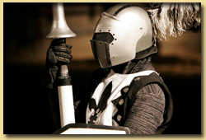
Activity! Coat of Arms

Slide 93
Activity! Coat of Arms
A Coat of Arms has long been a symbol of a family's identity and values. Originally used to identify warriors dressed in armor, each knight chose symbols and colors to represent his family or clan.

Slide 94
Activity! Coat of Arms
A Coat of Arms has long been a symbol of a family's identity and values. Originally used to identify warriors dressed in armor, each knight chose symbols and colors to represent his family or clan.

Slide 95
Activity! Coat of Arms
A Coat of Arms has long been a symbol of a family's identity and values. Originally used to identify warriors dressed in armor, each knight chose symbols and colors to represent his family or clan.

Slide 96
Activity! Coat of Arms
Please create a Coat of Arms about yourself to share to the class tomorrow.

Slide 97
Coat of Arms Activity! Please answer the following question on the back of your shield .
How will my actions affect my hopes and dreams this year and beyond?

